Slide 1
SPRING VALLEY VILLAGE POLICE DEPARTMENT
MONTHLY NEWSLETTER:
JANUARY 2025
1025 CAMPBELL ROAD
HOUSTON, TX 77055
PHONE: 713-465-8323
COMMUNITY MATTERS.
WE ARE A TEAM.

Slide 2
INTRODUCTION
Hilshire Village Residents,
We hope you had a Merry Christmas and a wonderful beginning to 2025! Be sure to check our information regarding tax and social security scams.
RESOLUTIONS FOR THE NEW YEAR:
Be sure to lock all doors and windows in your home, when you are not on the premises.
Lock your vehicle when it is unoccupied.
Make sure packages are retrieved promptly or hidden from view of the street.
Sincerely,
Chief M. Schulze
1025 CAMPBELL ROAD, HOUSTON, TX 77055
PHONE: 713-465-8323 / EMAIL: DISPATCH@SPRINGVALLEYTX.COM

Slide 3
JANUARY 2025
DATE | DAY | SPECIAL DAYS FOR THIS MONTH
JANUARY 01, 2025 | WEDNESDAY | NEW YEAR’S DAY
JANUARY 09, 2025 | THURSDAY | LAW ENFORCEMENT APPRECIATION DAY
JANUARY 20, 2025 | MONDAY | MARTIN LUTHER KING JR DAY
COMMUNITY MATTERS.
WE ARE A TEAM.
1025 CAMPBELL ROAD, HOUSTON, TX 77055 / PHONE: 713-465-8323 / EMAIL: DISPATCH@SPRINGVALLEYTX.COM

Slide 4
COMMUNITY MATTERS.
WE ARE A TEAM.
City Hall will be closed on Wednesday, January 01, 2025 in observance of the New Year holiday. You can always reach your Police Department Dispatch at 713-465-8323 if needed.
1025 CAMPBELL ROAD, HOUSTON, TX 77055
PHONE: 713-465-8323 / EMAIL: DISPATCH@SPRINGVALLEYTX.COM

Slide 5
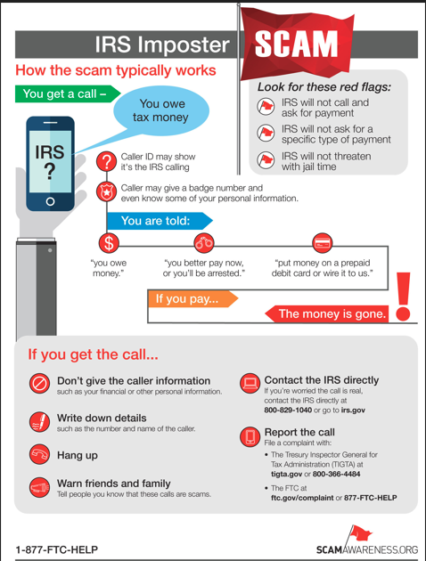
COMMUNITY MATTERS.
WE ARE A TEAM.
1025 CAMPBELL ROAD, HOUSTON, TX 77055
PHONE: 713-465-8323 / EMAIL: DISPATCH@SPRINGVALLEYTX.COM

Slide 6
COMMUNITY MATTERS.
WE ARE A TEAM.
1025 CAMPBELL ROAD, HOUSTON, TX 77055 / PHONE: 713-465-8323 / EMAIL: DISPATCH@SPRINGVALLEYTX.COM

Slide 7
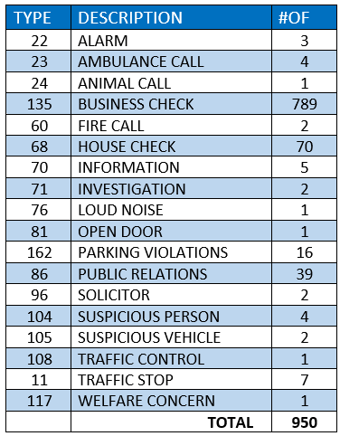
SPRING VALLEY POLICE DEPARTMENT
HILSHIRE VILLAGE
CALLS BY TYPE: 12/01/24 THRU 12/31/25
COMMUNITY MATTERS.
WE ARE A TEAM.
1025 CAMPBELL ROAD, HOUSTON, TX 77055
PHONE: 713-465-8323 / EMAIL: DISPATCH@SPRINGVALLEYTX.COM

Slide 8
IMPORTANT NUMBERS AT A GLANCE
EMERGENCY |  | NON - EMERGENCY
911 - FOR ALL EMERGENCY |  | 713-465-8323
988 – NATIONAL SUICIDE & MENTAL HEALTH
SPRING VALLEY VILLAGE |  | VILLAGE FIRE DEPARTMENT
SPRING VALLEY - CITY HALL | 713-465-8308 | VILLAGE FIRE DEPARTMENT |  | 713-465-2323
SPRING VALLEY - PD | 713-465-8323 | VFD - NON-EMERGENCY |  | 713-468-7941
SPRING VALLEY - PD FAX | 713-465-3135
SPRING VALLEY - COURT | 713-465-0333
HILSHIRE VILLAGE
HILSHIRE VILLAGE – CITY HALL | 713-973-1779
COMMUNITY MATTERS.
WE ARE A TEAM.
1025 CAMPBELL ROAD, HOUSTON, TX 77055 / PHONE: 713-465-8323 / EMAIL: DISPATCH@SPRINGVALLEYTX.COM

